Slide 1

Angular
Introduction

Slide 2
WTF is Angular?

Slide 3
How can I create an Angular App?
Use the @angular/cli
To see more about cli here.

Slide 4
So that's all what we need to create an Angular App?

Slide 5



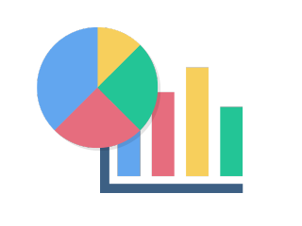

Recommended third party libs
Internationalization: ngx-translate
Modals: ngneat/dialog
Toast alerts: scttcper/ngx-toastr
Charts: ngx-charts
Drag & drop, trees, scroll, accordion, etc.: @angular/cdk

Slide 6



Personal recommendation
Easy test configuration: ngneat/spectator
Mocks for angular: ike18t/ng-mocks
State management
NgRx
dataorama/akita
OR

Slide 7
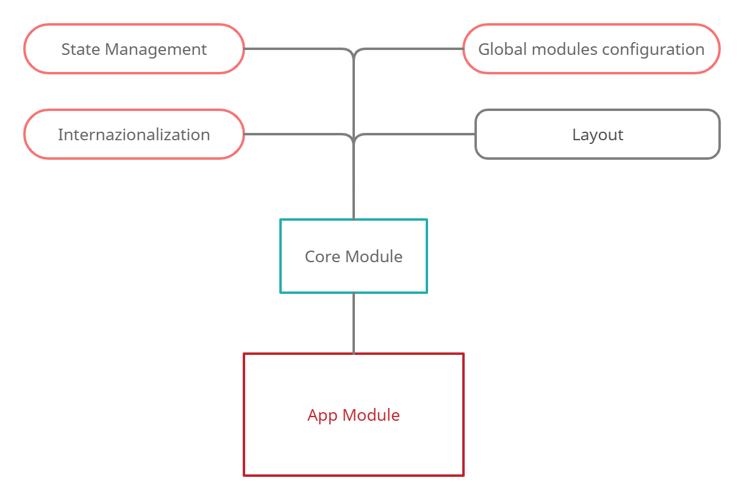
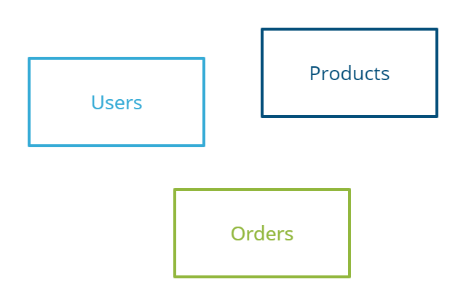
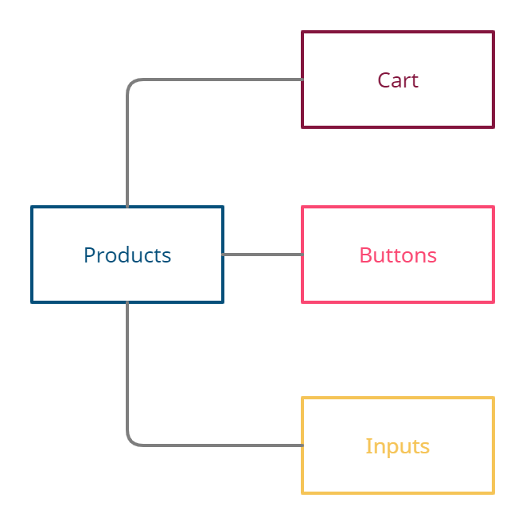
How do I build an Angular App?
We need to create modules that represents our features
Core Module
Feature Modules
Shared Modules

Slide 8
Let’s code!!

Slide 9
Challenge #1: Use APP_INITIALIZER
Inject as provider ConfigurationService in app.module.
We need to add a provider of APP_INITIALIZER in app.module
This provider needs a factory that receive as deeps ConfigurationService.
The factory should call our ConfigurationService .loadConfiguration method*
Remove the use of config Service in whole app that are before every service call to ensure the configuration is done.
* In angular (12 > x) the APP_INITIALIZER only accepts promises as return of factory, in angular 12 or more we can return an observable. (The project is in angular v11.2)
To see more about APP_INITIALIZER here.

Slide 10
Challenge #2: Communication Patterns
We need to refactor the child component, to only emit the string is typed inside the input.
Parent component should receive the string emitted by child component and make a call to our pokemon.service
Update the data of selected property when we receive the API response.
To know more about communication pattern you can read it here.

Slide 11
Challenge #3: Handle subscriptions
We need to get the subscription of all subscribes in our pokemon-detail.component.
In the OnDestroy hook we need to unsubscribe of all of subscriptions.

Slide 12
Challenge #4: Handle in single subscription
Instead of create several properties for every subscription we can use only one Subscription and use add method in every subscribe.

Slide 13
Challenge #5: Handle subscription with subject
Create a subject that we would call to unsubscribe of all subscriptions.
Add in each subscription the takeUntil operator and set the destroy subject.
Call next and complete of our destroy subject in OnDestroy hook.

Slide 14
Challenge #6: Use pipeline to group into a single subscription
Use pipe and rxjs operator to only make one subscription.
Remove subscription property and add it into a pokemon.description property.
Update UI to load data of description from pokemon.description.

Slide 15
Challenge #7: Remove subscription and use Async pipe
Instead of define a property pokemon that is the type pokemon, we would define pokemon$: Observable<Pokemon>.
Then we assign our observable directly into our property, without make the subscribe.
Instead of use our pokemon property in our UI we are going to use pokemon$ | async.

Slide 16
Challenge #8: Lazy load
Now we are importing inside the app.module all of app modules and we need to remove it.
Then we need to create a routing-module for every module (in the project we have it done).
In app-routing module instead of call the component we want to render we are going to use loadChildren to make an import of the owner module of this component.

Slide 17
Challenge #9: Preload strategy
We are going to implement a preload strategy based on network connection type.
This strategy would check if the user connection is 3g or less.
If user has better connection than 3g, we are going to download all the modules after we have downloaded the main.js bundle.
If user has connection of 3g or worse connection we only load the modules when the user navigates to our pages.
To know more about this implementation you can read it here.

Slide 18
Bonus challenge #10: Dependency injection
Create an injection token to identify our injectable environment.
Build a provider and use it in app.module.
Inject this dependency in pokemon service and check that everything still works.
Override the provider inside the pokemon.service.spec.ts to manage the apiUrl in the context of our testing environment.

Slide 19
Q&A

